Slide 1
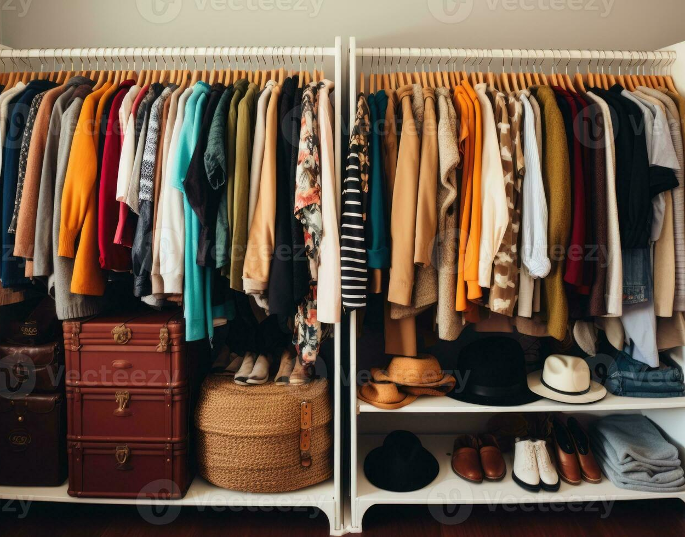
FashionAI_Companion
Your Personal Fashion Advisor
Presented by:
LAL PRASATH L , BE-CSE, III YEAR
SIR ISSAC NEWTON COLLEGE OF ENGINEERING & TECHNOLOGY

Slide 2
AGENDA
PROJECT STATEMENT
PROJECT OVERVIEW
PROJECT MODELLING
RESULTS
SOLUTION AND ITS PROPOSITIONS
WOWS IN MY SOLUTION
APPLICATION AREAS

Slide 3
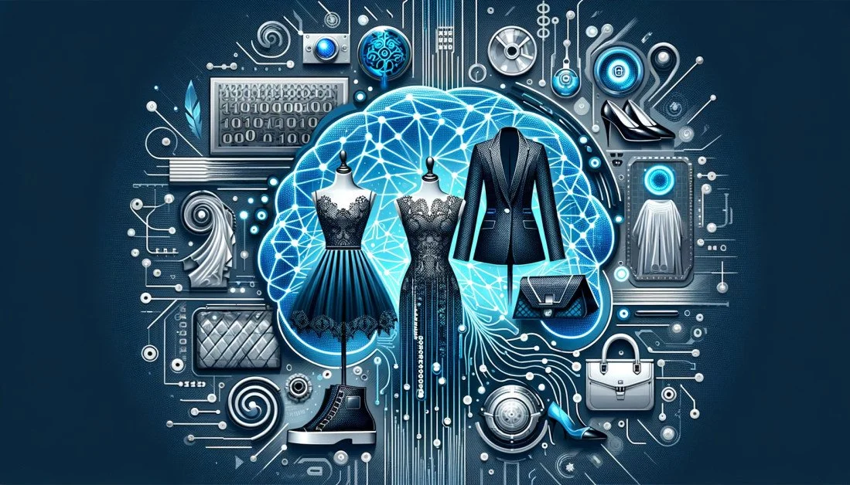
PROJECT STATEMENT
Empowering individuals with personalized fashion guidance through cutting-edge AI technology.
Our Fashion AI Companion revolutionizes the way people approach style decisions, offering tailored outfit suggestions, trend insights, and wardrobe organization support. Seamlessly integrating with daily routines, our companion enhances confidence and creativity in every wardrobe choice.

Slide 4
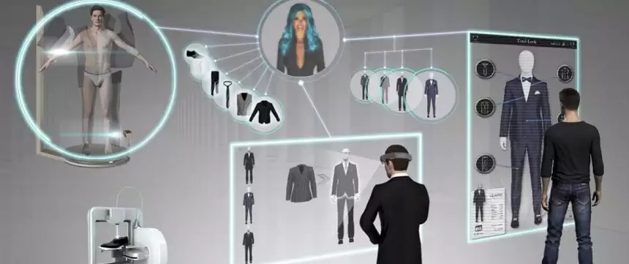
PROJECT OVERVIEW
Our project focuses on the development of a Fashion AI Companion, leveraging artificial intelligence to provide personalized fashion assistance to users.
By harnessing machine learning algorithms, natural language processing, and image recognition technologies, our companion offers a range of functionalities including outfit suggestions, trend analysis, wardrobe organization, and styling tips.
With an intuitive user interface and seamless integration with external APIs and services, our aim is to revolutionize the fashion industry by empowering individuals with intelligent and accessible style guidance.

Slide 5
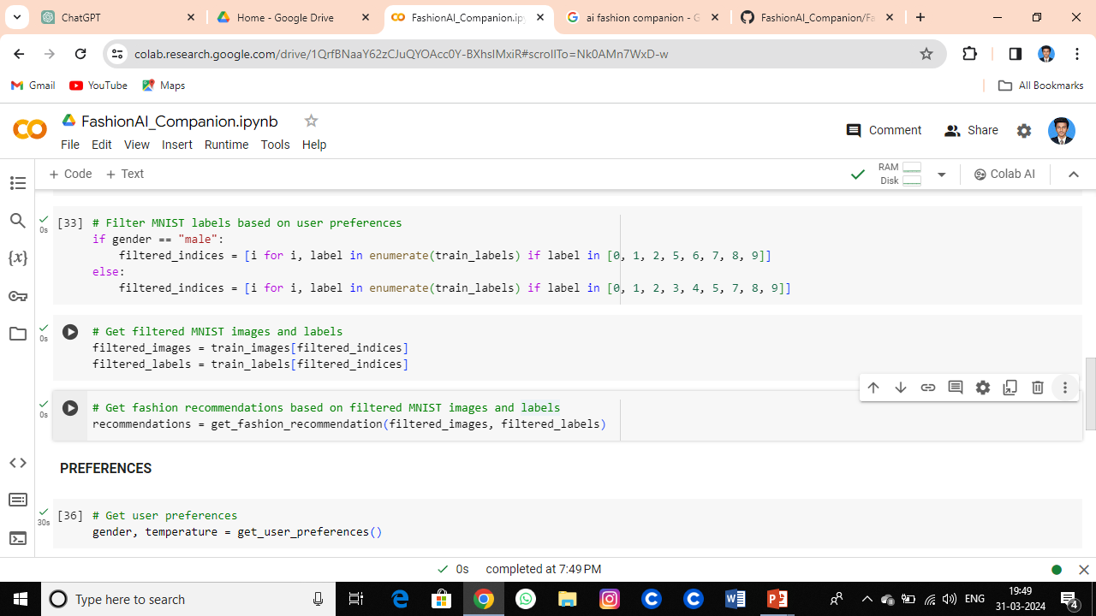
PROJECT MODELLING

Slide 6
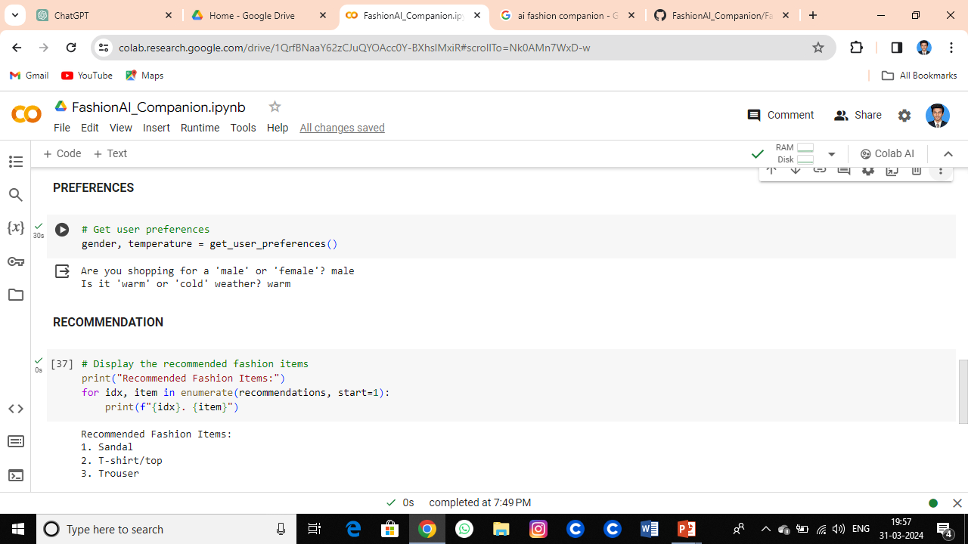
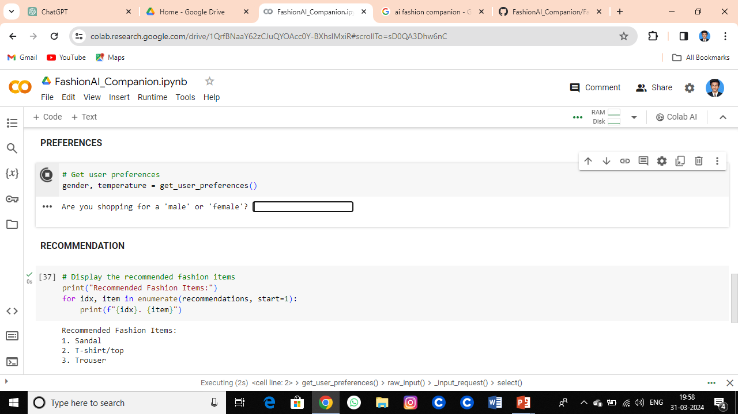
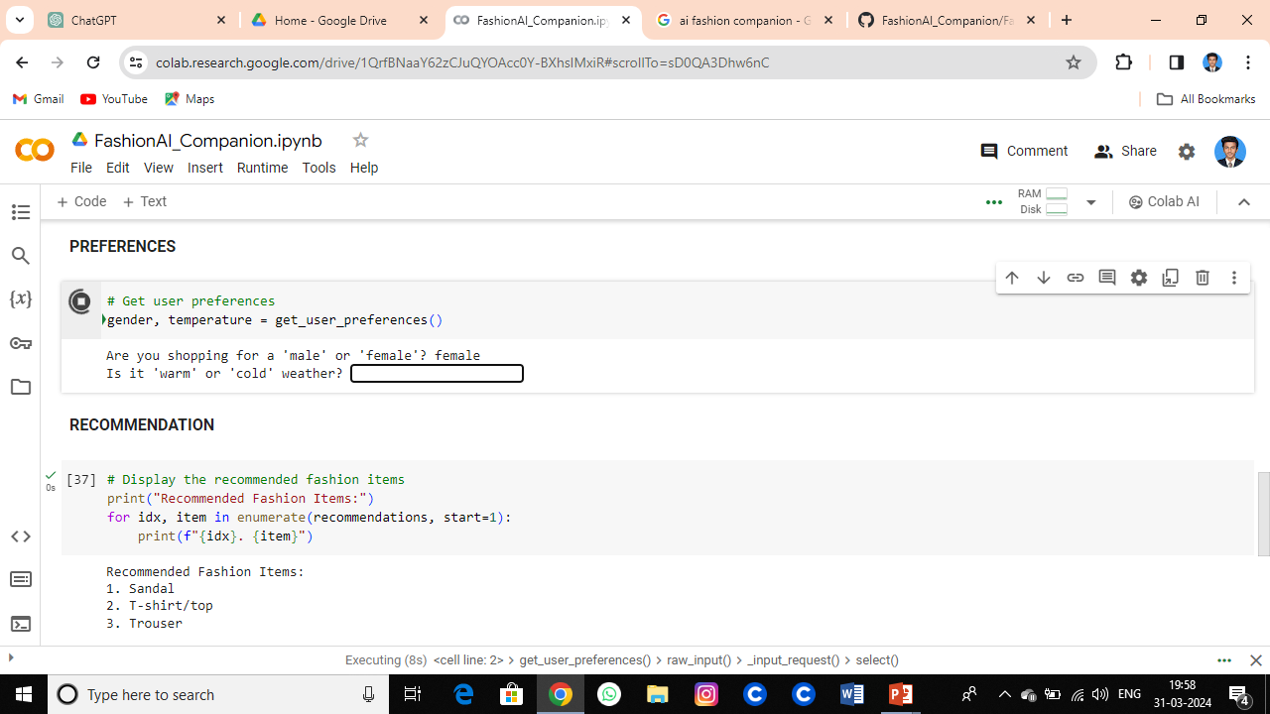
RESULTS
Building on our initial success, we are committed to further enhancing and refining our fashion AI companion.
Future developments may include advanced features such as augmented reality (AR) try-on, integration with smart devices, and personalized fashion recommendations based on contextual factors such as location and occasion.

Slide 7
SOLUTION AND ITS PROPOSITIONS
Personalized Fashion Guidance: Our AI companion provides personalized outfit suggestions, trend insights, and styling tips tailored to individual preferences and lifestyle.
Effortless Wardrobe Management: Seamlessly organize and categorize your wardrobe with intelligent algorithms, facilitating easy access to clothing items and outfit combinations.
Empowering Self-Expression: Inspire confidence and creativity in your style choices, empowering you to express your unique personality through clothing with ease and authenticity.

Slide 8
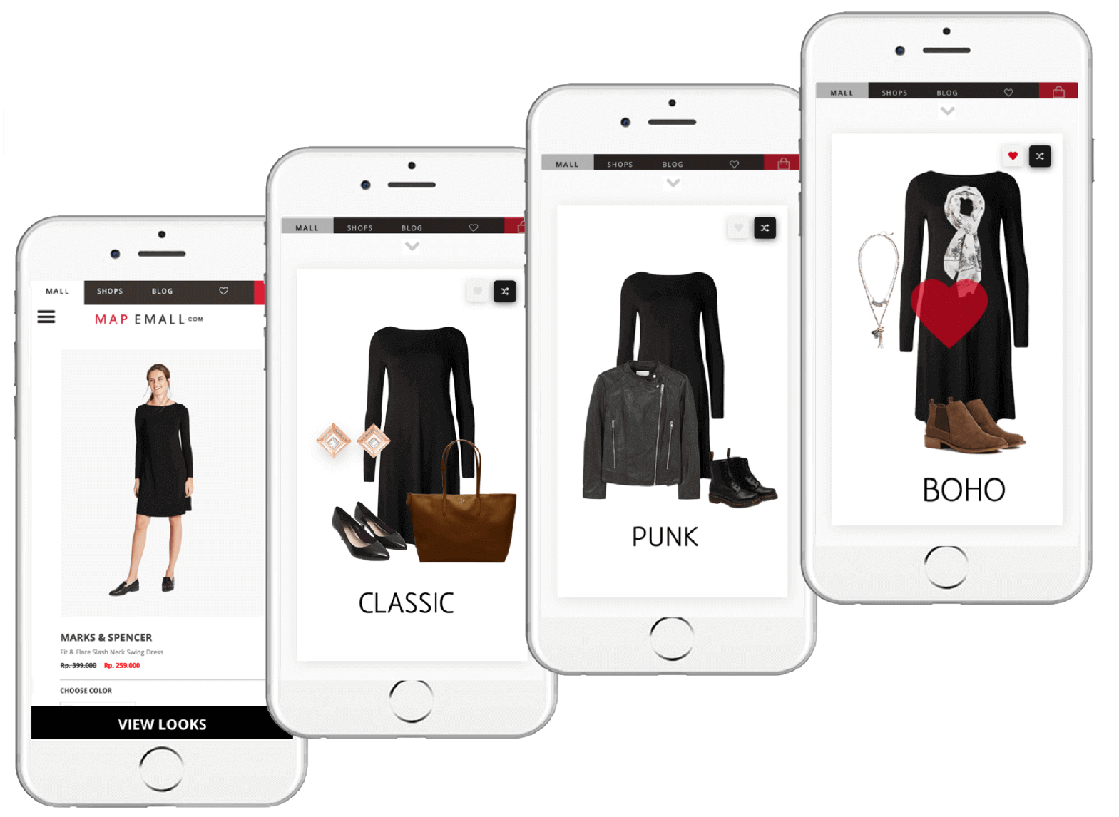
WOWS IN MY SOLUTION
Personalized Fashion Intelligence: Tailored recommendations based on individual preferences.
Seamless Integration: Accessible across devices and platforms for effortless fashion assistance.
Innovative Wardrobe Management: Intuitive algorithms simplify wardrobe organization.
Real-time Trend Insights: Stay ahead with up-to-date fashion trend analysis.
Enhanced Shopping Experience: Informed purchasing decisions through integrated services.
Empowering Self-Expression: Fostering confidence and creativity in personal style.

Slide 9
APPLICATION AREAS
Personal Fashion Assistant: Tailored outfit suggestions, styling tips, and trend insights for individuals.
Retail and E-commerce: Enhanced shopping experiences with personalized recommendations and virtual try-on.
Fashion Industry Professionals: Trend analysis, inspiration, and market insights for designers, stylists, and marketers.
Wardrobe Management Solutions: Efficient organization and optimization of wardrobe selection.
Fashion Education and Research: Access to comprehensive datasets and trend analysis tools for students and researchers.
Event Planning and Styling: Assistance in selecting attire and coordinating outfits for special occasions.
Social Media and Influencer Marketing: Trend insights and recommendations for influencer partnerships and content creation.

Slide 10
REFERENCE
https://github.com/Lalprasath00/GENRATIVE-AI.git

Slide 11

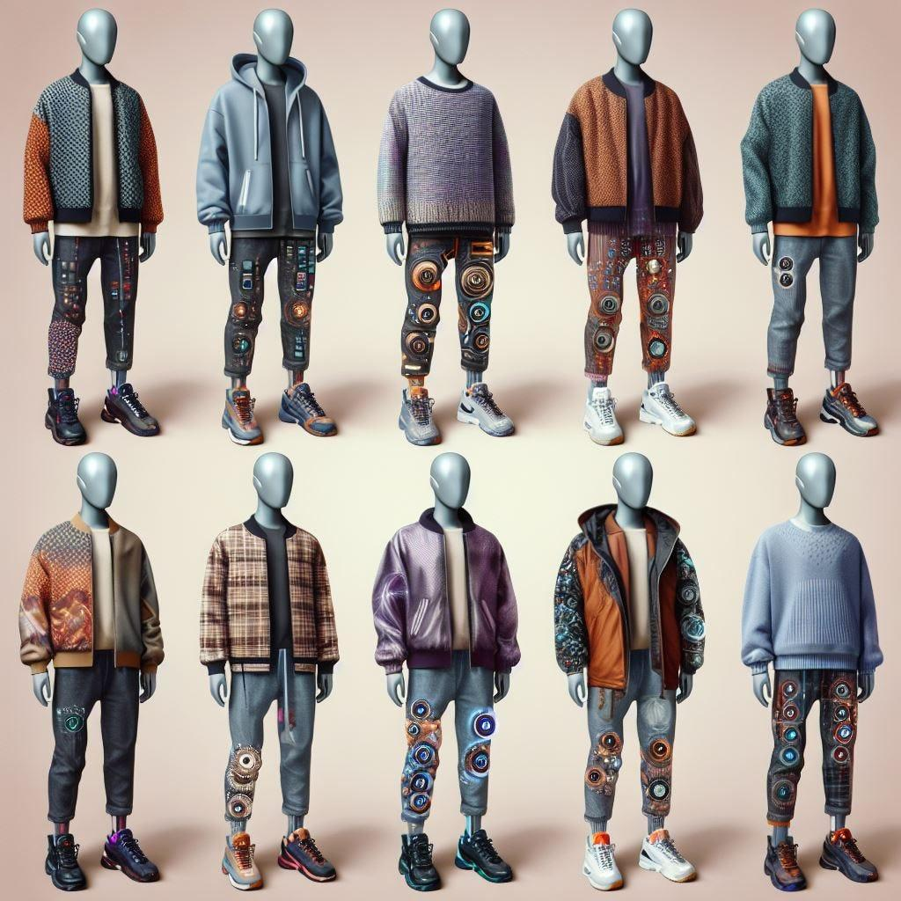
CONTACT:
lalprasath00@gmail.com

